Slide 1
Eat – Sleep –Code - Repeat
NXP
University Course

Slide 2
Course Contents
General topics, Courses & Labs
General Presentation of the Course
V-Model, Requirements Engineering, Process | Understand and Create Requirements
Architecture (UML) | Virtual Machine Environment Setup
Process | Git, IDE Setup, Compile and Flash the Hello World Project
How Hardware and Software are Linked | From Compiling to Electrical Signals and Debugging
Microcontroller Features (I/O, PWM, ADC, DAC, Timer, Interrupts) | Hands-on Lab (no module – just the dev board)
Node 1: Lights (BCM)
Node 2: Steering
Node 3: Transmission
Node 4: Brakes
Node 5: Door Control + HVAC
Node 6: HMI and CAN Communication

Slide 3
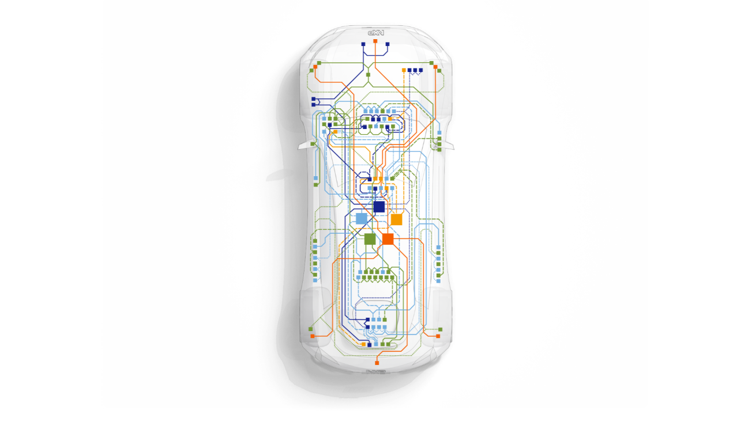






REPLI-CAR NETWORK
Steering control node
Replicate Steering Control Module behavior
· steer base on input controller (steer controller) from HMI
· Communications with other nodes: HMI, PCM, BCM
body control node
Replicate Body Control Module behavior
· Actuate lights (headlamps, turn indicators), horn and washer pump based on input controller from HMI
· Communications with other nodes: HMI, PCM, Brake, Steering, Comfort
steering
bcm
Powertrain control node
Replicate Engine and Transmission Modules behavior
· Accelerate/Decelerate based on input controller from HMI
· Communications with other nodes: HMI, Brake, BCM
hmi node
Replicate Human Machine Interface Module behavior
· handle input/output controllers that actuate different nodes in Repli-Car network. Display information received from the nodes
· Communications with other nodes: Steering, Comfort, PCM, BCM
pcm
HMI
brake control node
Replicate Brake Control Module behavior
· brake actuation and brake lamp indication based on input controller from HMI
· Communications with other nodes: HMI, PCM, BCM
comfort control node
Replicate Comfort Module behavior
· actuate window motor and ventilator using input controller commands from HMI
· Communications with other nodes: HMI, BCM
brake
comfort

Slide 4
V-Model

Slide 5
The V-MODEL
Requirements Design
Acceptance Test
Known as verification and validation model
It is similar to waterfall model that follows a sequential path of execution of processes
Devised by the late Paul Rook in 1980s, V-model was targeting the improvement of software development
It is a step-by-step process in which the next phase begins only after the completion of the present phase
If this model is used to test a product, there is an assurance that the final product developed will be of high quality
System Design
System Test
Architecture Design
Integration Test
Model Design
Unit Test
Coding

Slide 6
Phases of V-Model – Verification phase
The verification phase of V-model includes:
Business requirement analysis is the stage of having a detailed communication with the customer so that it gets easier to understand his/her exact requirements.
System design stage involves understanding and detailing out the entire hardware and communication setup for the product being developed. System test design can also be planned at this stage
Architectural design stage involves understanding the technical and financial feasibility of the product before it is actually developed. The focus is to understand the data transfer that will take place between internal and external modules
Module design stage focuses on designing a detailed plan for the internal modules of the system. Also known as low-level design, it is important to ensure that the design is compatible with other modules in system architecture and other external systems
Notes:
Business requirement: It is beneficial to complete acceptance test design planning at this stage

Slide 7
Phases of V-Model – CODING phase
During this phase, the actual coding of the system modules is taken up
On the basis of system and architectural requirements of the program, the best suitable programming language is selected using which the coding is done at par with the coding guidelines and standards; the code is then reviewed and optimized to ensure the delivery of best performing product

Slide 8
Phases of V-Model – Verification phase
During this phase, the product undergoes various forms of testing.
Unit testing is conducted at an early stage so that the bugs are eliminated at the starting stages of product development
Integration testing is done to check whether there is a valid and proper communication within the internal modules of the system
System testing enables the testing of the entire system and to ensure if the internal modules communicate effectively with the external systems
Acceptance testing is done to test a product in the user’s environment and to check if it’s compatible with the other systems available in the environment

Slide 9
Requirements Engineering

Slide 10
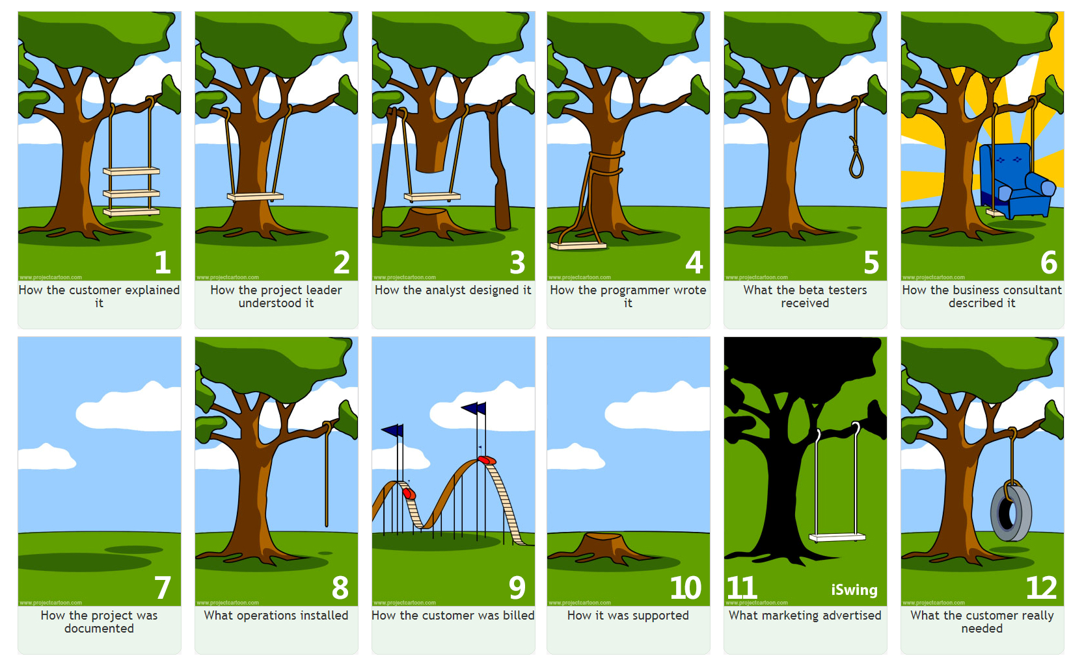
What is requirements engineering?
Notes:
When a customer describes what s/he wants, it tends to be true that s/he always overstates it.
The product owner gathers the customer's requirement and summaries it.
Engineers follow PO's summary and make it work. Well, to some extent...
Then programmers will write it. However, when you test it, it is not workable.
Finally, we have a product, so the sales can start their job by exaggerating its features.
When you want to check the document, it is always nowhere to be found.
What the operations build is simply a rope. Gosh, I don't know what to say.
Customers are billed for extraordinary experiences.
The way Helpdesk solves problems is just simple and "radical".
Voila! It turns out what the customer truly wants is just a simple tire swing.

Slide 11
What is requirements engineering?
Requirements Engineering (RE) is the process of discovering, analyzing, documenting and validating the requirements of the system
Each software development process goes through the phase of requirements engineering
The processes used for RE vary widely depending on the application domain, the people involved and the organization developing the requirements
However, there are a number of generic activities common to all processes:
Requirements elicitation
Requirements analysis
Requirements validation
Requirements management

Slide 12
Requirements engineering – Elicitation and analysis
Sometimes called requirements elicitation or requirements discovery
Involves technical staff working with customers to find out about the application domain, the services that the system should provide and the system’s operational constraints
May involve end-users, managers, engineers involved in maintenance, domain experts, trade unions, etc. These are called stakeholders

Slide 13
Requirements engineering – Problems of requirements analysis
Stakeholders don’t know what they really want
Stakeholders express requirements in their own terms
Different stakeholders may have conflicting requirements
Organizational and political factors may influence the system requirements
The requirements change during the analysis process.
New stakeholders may emerge and the business environment change

Slide 14
The requirements analysis process
Domain Understanding
Requirements Collection
Classification
Conflict Resolution
Prioritization
Requirements Validation
Requirements Definition and Specification

Slide 15
Process activities & Viewpoint-oriented elicitation
Process activities:
Domain understanding
Requirements collection
Classification
Conflict resolution
Prioritization
Requirements checking
Viewpoint-oriented elicitation:
Stakeholders represent different ways of looking at a problem or problem viewpoints
This multi-perspective analysis is important as there is no single correct way to analyze system requirements

Slide 16
Requirements validation
Validation
Concerned with demonstrating that the requirements define the system that the customer really wants​
Requirements error costs are high, so validation is very important​
Fixing a requirements error after delivery may cost up to 100 times the cost of fixing an implementation error​
Requirements management is the process of managing changing requirements during the requirements engineering process and system development​
Requirements are inevitably incomplete and inconsistent​
New requirements emerge during the process as business needs change and a better understanding of the system is developed​
Different viewpoints have different requirements and these are often contradictory​

Slide 17
Enduring and volatile requirements
Enduring requirements
Stable requirements derived from the core activity of the customer organization. E.g. a hospital will always have doctors, nurses, etc. May be derived from domain models
Volatile requirements
Requirements which change during development or when the system is in use. In a hospital, requirements derived from health-care policy

Slide 18
Classification of requirements
Mutable requirements
Requirements that change due to the system’s environment
Emergent requirements
Requirements that emerge as understanding of the system develops
Consequential requirements
Requirements that result from the introduction of the computer system
Compatibility requirements
Requirements that depend on other systems or organizational processes

Slide 19
Traceability
Traceability is concerned with the relationships between requirements, their sources and the system design
Source traceability
Links from requirements to stakeholders who proposed these requirements
Requirements traceability
Links between dependent requirements
Design traceability
Links from the requirements to the design

Slide 20
Writing Good Requirements
A good requirement states something that is necessary, verifiable, and attainable.
Need. If there is a doubt about the necessity of a requirement, then ask: What is the worst thing that could happen if this requirement were not included? If you do not find an answer of any consequence, then you probably do not need the requirement.
Verification. As you write a requirement, determine how you will verify it.
Attainable. To be attainable, the requirement must be technically feasible and fit within budget, schedule, and other constraints.
Clarity. Each requirement should express a single thought, be concise, and simple. It is important that the requirement not be misunderstood – it must be unambiguous.
Simple sentences will most often suffice for a good requirement.
Notes:
A good requirement states something that is necessary, verifiable, and attainable.
Even if it is verifiable and attainable, and eloquently written, if it is not necessary, it is not a good requirement. To be verifiable, the requirement must state something that can be verified by examination, analysis, test, or demonstration. Statements that are subjective, or that contain subjective words, such as "easy", are not verifiable. If a requirement is not attainable, there is little point in writing it. A good requirement should be clearly stated.
Need. If there is a doubt about the necessity of a requirement, then ask: What is the worst thing that could happen if this requirement were not included? If you do not find an answer of any consequence, then you probably do not need the requirement.
Verification. As you write a requirement, determine how you will verify it. Determine the criteria for acceptance. This step will help ensure that the requirement is verifiable.
Attainable. To be attainable, the requirement must be technically feasible and fit within budget, schedule, and other constraints. If you are uncertain about whether a requirement is technically feasible, then you will need to conduct the research or studies to determine its feasibility. If still uncertain, then you may need to state what you want as a goal, not as a requirement. Even if a requirement is technically feasible, it may not be attainable due to budget, schedule, or other, e.g., weight, constraints. There is no point in writing a requirement for something you cannot afford -- be reasonable.
Clarity. Each requirement should express a single thought, be concise, and simple. It is important that the requirement not be misunderstood -- it must be unambiguous. Simple sentences will most often suffice for a good requirement.

Slide 21
Writing Good Requirements - Use of terms
In a specification, there are terms to be avoided and terms that must be used in a very specific manner. Authors need to understand the use of shall, will, and should:
Requirements use shall
Statements of fact use will
Goals use should.
These are standard usage of these terms. You will confuse everyone if you deviate from them. All shall statement (requirements) must be verifiable, otherwise, compliance cannot be demonstrated.
Terms such as are, is, was, and must do not belong in a requirement. They may be used in a descriptive section or in the lead-in to a requirements section of the specification.
There are several terms to be avoided in writing requirements, because they confuse the issue and can cost you money, e.g.: support, but not limited to, etc., and/or

Slide 22
Writing Good Requirements - Use of terms
The word support is often used incorrectly in requirements. Support is a proper term if you want a structure to support 50 pounds weight. It is incorrect if you are stating that the system will support certain activities.
WRONG: The system shall support the training coordinator in defining training scenarios.
RIGHT: The system shall provide input screens for defining training scenarios. The system shall provide automated training scenario processes.
The terms but not limited to, and etc. are put in place because the person writing the requirements suspects that more may be needed than is currently listed. Using these terms will not accomplish what the author wants and can backfire.

Slide 23
Writing Good Requirements – Structure/grammar
Requirements should be easy to read and understand. The requirements in a system specification are either for the system or its next level (e.g.: subsystem). Each requirement can usually be written in the format:
The System shall provide …
The System shall be capable of...
The System shall weigh...
The Subsystem #1 shall provide ...
The Subsystem #1 shall interface with...
Note: The name of your system and the name of each subsystem appear in these locations. If you have a complex name, please use the acronym, or your document will have many unneeded pages just because you have typed out a long name many times

Slide 24
Writing Good Requirements – Structure/grammar
Each of these beginnings is followed by what the System or Subsystem shall do.
Each should generally be followed by a single predicate, not by a list.
Requirement statements should not be complicated by explanations of operations, design, or other related information. This non-requirement information should be provided in an introduction to a set of requirements or in rationale.
You can accomplish two things by rigorously sticking to this format:
First, you avoid the Subject Trap.
Second, you will avoid bad grammar that creeps into requirements when authors get creative in their writing

Slide 25
Writing Good Requirements – Structure/grammar - Subject trap
A set of requirements might be written that reads as follows:
The guidance and control subsystem shall provide control in six degrees of freedom.
The guidance and control subsystem shall control attitude to 2+/- 0.2 degrees.
The subject trap is created because the author has defined a guidance and control subsystem. Controlling attitude and rate is a system problem; it requires not only a guidance and control subsystem but also a propulsion subsystem to achieve these attitudes and rates. The requirements should be written from the system perspective, as follows:
The system shall provide six degrees of freedom control.
The system shall control attitude to 2 +/- 0.2 degrees.

Slide 26
Writing Good Requirements – Structure/grammar - Bad grammar
Bad grammar → reader will misinterpret what is stated.
Avoid it by writing requirements as bullet charts. When the content is agreed upon a good writer can convert the information into a sentence for the specification.
Authors will also try to put all that they know in a single sentence. This results in a long complex sentence that probably contains more than one requirement. Bullet charts or one good editor can alleviate this problem.

Slide 27
Writing Good Requirements – Verifiable
Requirements may be unverifiable for several reasons. The following discusses the most common reason: use of ambiguous terms – because they are subjective (different meanings to different people).
Avoid these words:
Minimize / Maximize
Rapid
User-friendly
Easy
Sufficient
Adequate
Quick

Slide 28
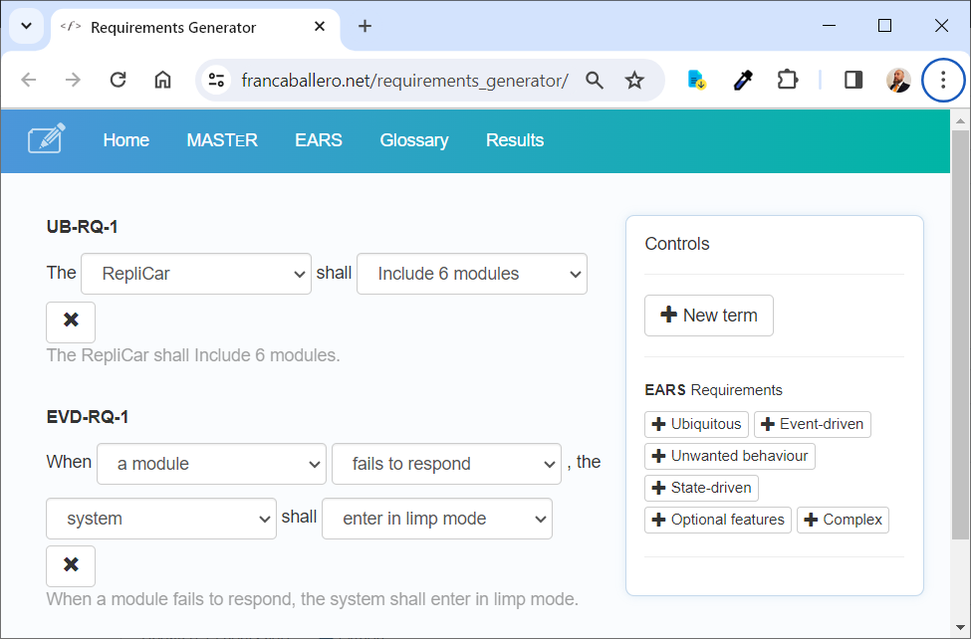
Writing Good Requirements – Tools
Requirements generator https://francaballero.net/requirements_generator/ Example: Easy Approach to Requirements Syntax (EARS)

Slide 29
References

Slide 30
References
Ian Sommerville, Software Engineering (International Computer Science Series), 22 Aug. 2000
Writing Good Requirements, https://spacese.spacegrant.org/uploads/Requirements-Writing/Writing%20Good%20Requirements.pdf
IEEE Guide for Developing System Requirements Specifications , https://www2.seas.gwu.edu/~mlancast/cs254/IEE_STD_1233-_Requirements_Spec.pdf
Requirements generator, https://francaballero.net/requirements_generator/

Slide 31
Overview of the change management process
Change/Feature/Bug Requests, Implementation (Coding), Review, Branch, Commit, PullRequest, Testing

Slide 32
Introduction in CHANGE MANAGEMENT PROCESS
The change management process refers to the stages involved in any change management strategy and its implementation. Having a strategy and steps helps transformations become successful and ensure that all factors are considered.
At a glance, the change management process breaks down into the following five steps:
1. Prepare for change.
2. Create a vision for change.
3. Implement changes.
4. Embed and solidify changes.
5. Review and analyze.

Slide 33
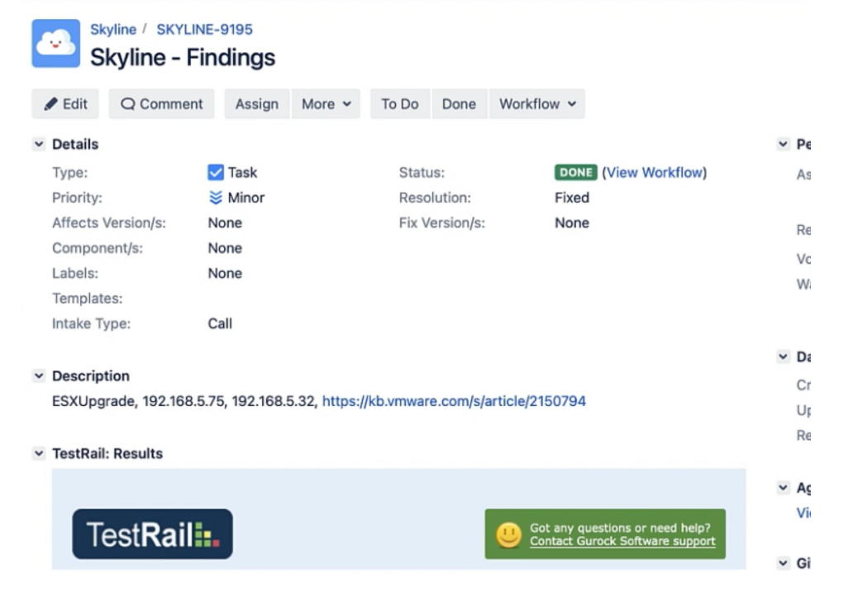
Introduction in Jira
What Is Jira?
Jira is a software application developed by the Australian software company Atlassian that allows teams to track issues, manage projects, and automate workflows.
Jira is based on four key concepts: issue, project, board, and workflow.

Slide 34
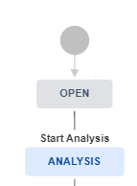

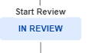

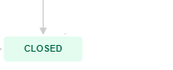
Simple schema
Jira Implementation Workflow

Slide 35
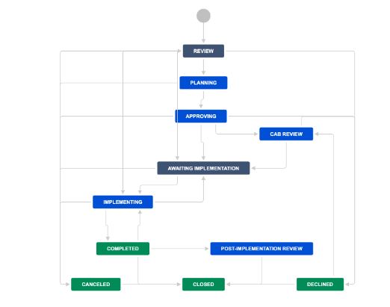
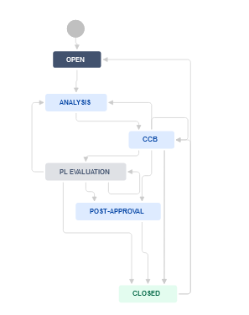
Change request flow
Jira Implementation Workflow

Slide 36
Support Tools Jira, Git, Bitbucket

Slide 37
JIRA
Log-in using Windows credentials
What can you do in Jira:
Plan and track several types of activities like tasks, sub-tasks, bugs, new- features, inquiries
Plan and track releases
Use queries (predefined or define your own)
Use the predefined Jira Reports
Visualize Jira project status
Integrate Jira with Git and PullRequest

Slide 38
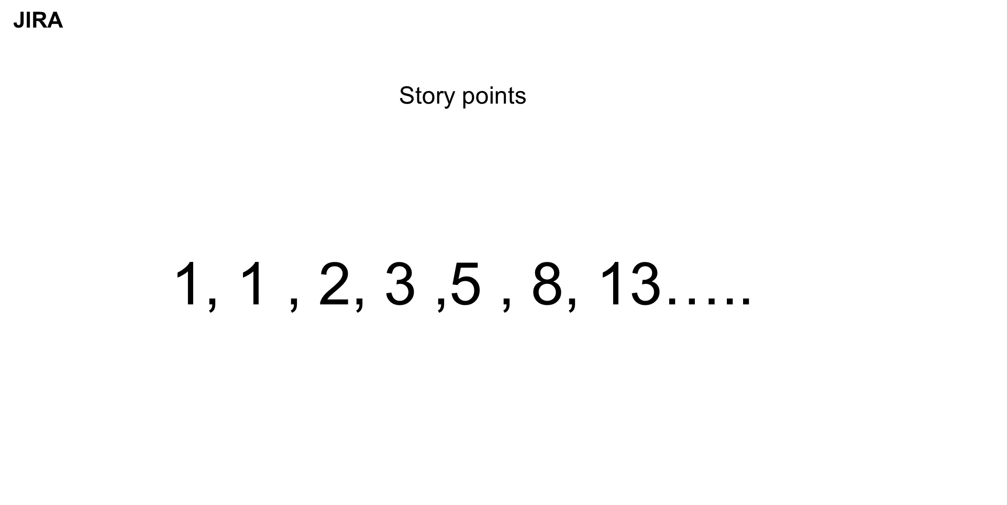

Slide 39
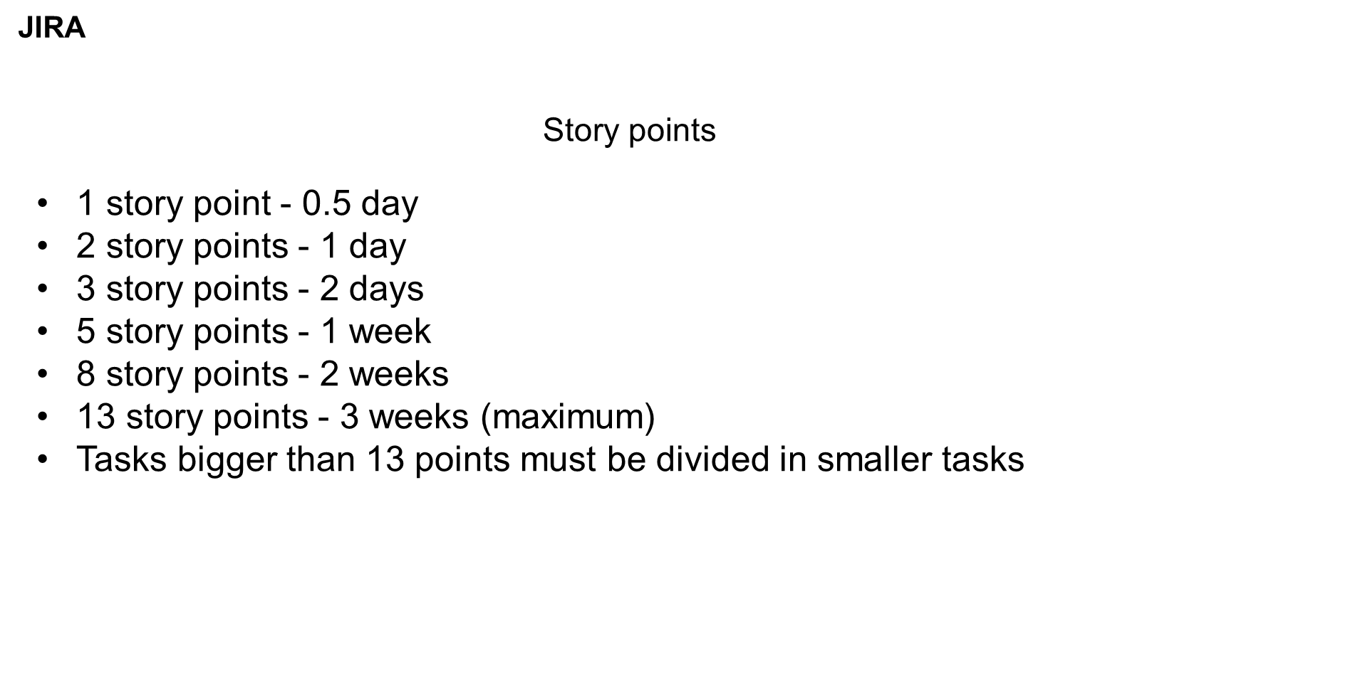

Slide 40
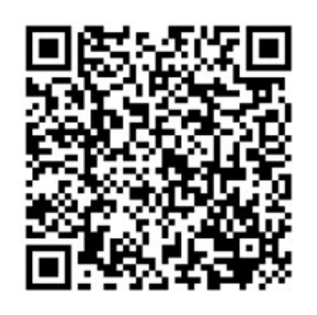
Repo from GitHub

Slide 41

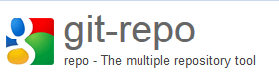


Working with Git
Command Line Interface
https://git-scm.com/downloads
Used in MCAL and OS projects
https://gerrit.googlesource.com/git-repo/
Source Tree GUI Client
https://www.sourcetreeapp.com/download/
https://bitbucket.sw.nxp.com/dashboard
NXP remote repo servers

Slide 42

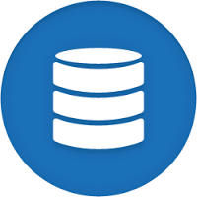


Centralized Version Control System
remote repository
moves changes (Push)
gets changes (Pull)
moves changes (Push)
gets changes (Pull)
Anne’s working directory
Bob’s working directory

Slide 43
Working with Git BASH & Source Tree
Main steps using Git Bash and Source Tree.
1. Clone the project repo. One time operation.
2. Create a branch from the JIRA ticket
3. Pull the branch
4. Checkout the branch
5. Add/update a source files
6. Commit the change
7. Pull the changes from remote repo
8. Push your change to remote repo, in the feature/ bugfix branch
9. Add a tag o the last commit form the feature/bugfix branch and push the tag
10. Merge the feature/bugfix branch to the official branch through BitBucket Pull Request

Slide 44
Git setup on git bash
Syntax highlighting:
git config --global color.ui auto
Introduce yourself:
git config --global user.name “Name“
git config --global user.email email
Check your settings:
git config --list
Or check a specific key’s configuration
git config <key>
e.g. Make a clone:
git clone …..
Git ducation
Notes:
to have syntax highlighting you can enter the first line.
in order for users to recognize your work commits, you must introduce yourself.
check your current configuration

Slide 45
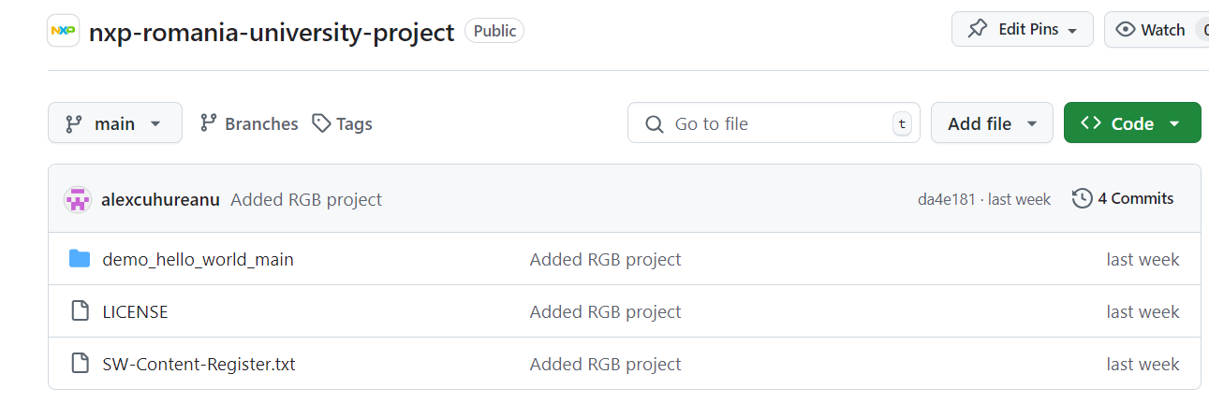
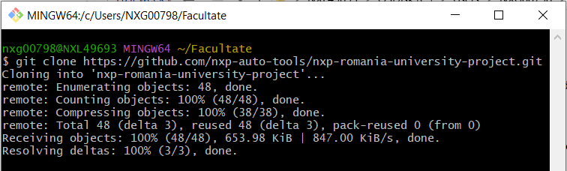
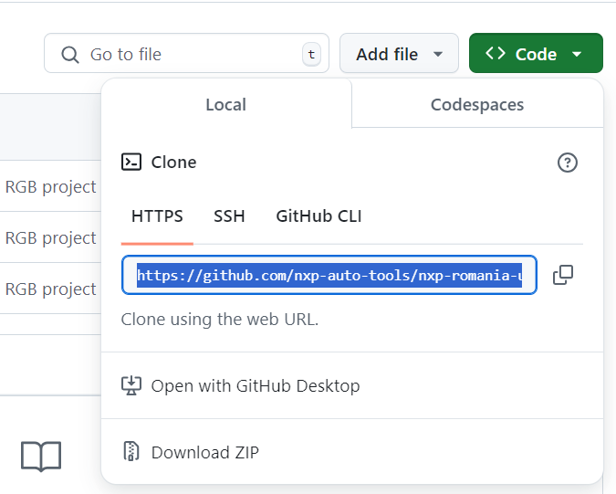

GitHub
Git Bash
| Clone a repository

Slide 46
Cloning a repo
Someone else’s repository can be located on their local file system or on a remote machine accessible via HTTP, HTTPS, SSH, etc.
To clone the repo onto your local machine:
git clone <url>
e.g. using SSH protocol:
git clone https://github.com/NXP/*repo*.git
SSH uses public-key authentication, so you’ll have to generate one.
Notes:
- you’ll need the location of your repo on the server.
- the repository hosting service used: Atlassian Stash.

Slide 47

Repository status
repository
working directory
(files on disk)
.git
random_project
Now, you can notice a .git directory in the initialized project directory (is hidden).
Deleting it will turn your project into a normal unmanaged collection of files
Next, you’ll want to see the status of the repository:
git status
Output:
On branch master
Initial commit
nothing to commit (create/copy files and use "git add" to track)
Notes:
the result of git init => a .git directory in project’s files.
running git status will show the current status of your repo.
git status will also show suggestions.

Slide 48
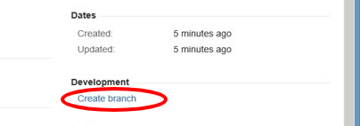
Create a branch from the JIRA ticket
Notes:
Go to the Jira issue you want to work on and when this issue requires modification of the data (source code, documentation etc.) stored under Git version control you should create appropriate Branch related to this issue.

Slide 49
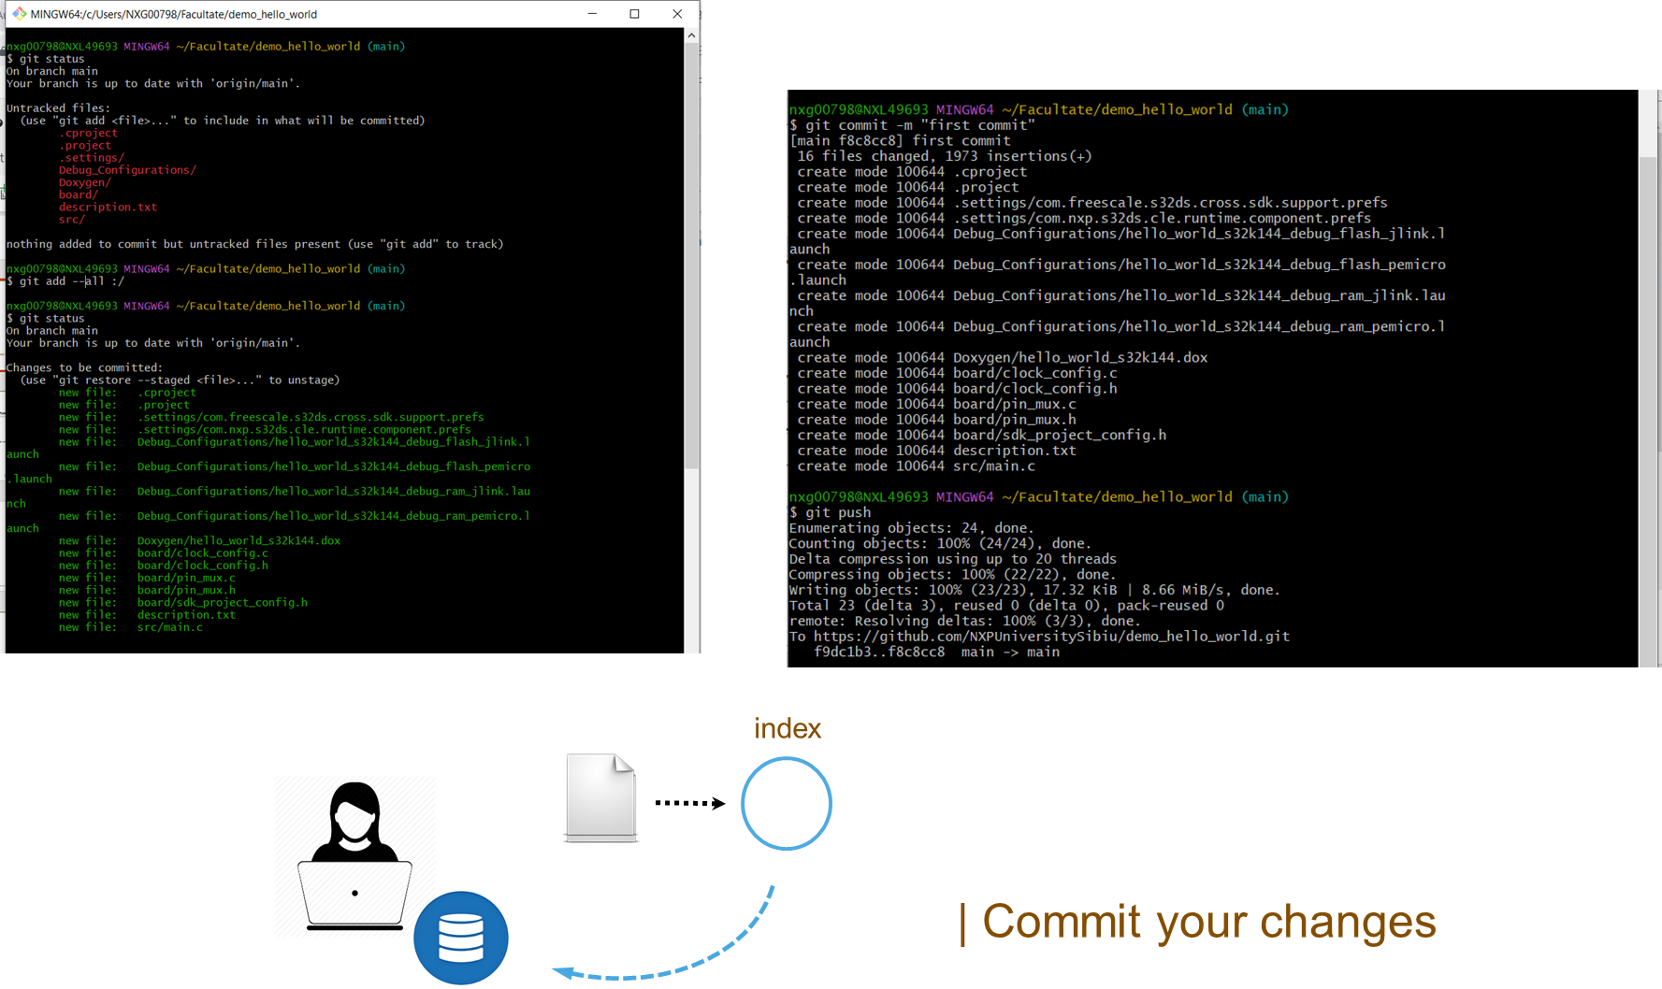

Slide 50
Committing files
Committing the snapshot
git commit -m "Added the module definitions and functionalities"
-m flag prevents the additional editor window message to pop up.
Your message should, however, be explicit enough to others.
To exit and save contents, hit Esc and then, enter :wq.
Note that git status only shows the uncommitted changes.
If you run it after a commit, it will show that you have no more files to commit. (only if you don’t add new files in your working directory in the meantime)
Notes:
commit your changes, write an explicit message for the specific commit.
check commit history

Slide 51
Checkout <branch>
git checkout <branch-name>
To return to the current (default) branch – master (restores current files in index and working directory):
git checkout master
master
HEAD
development
feature
Notes:
switches you on the specified branch (e.g. switch on master => head -> master)
the detached head appears only when you check out commits, as the head no longer points to your most recent commit.

Slide 52
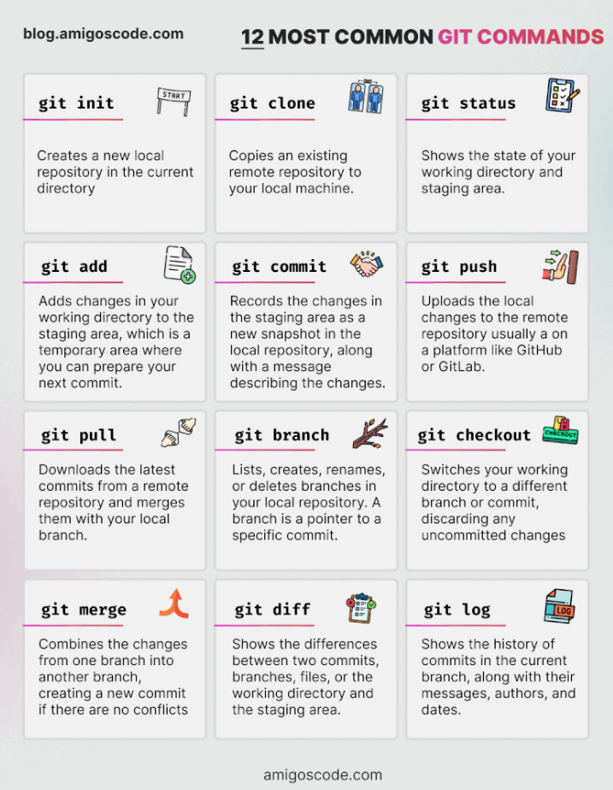
Notes:
switches you on the specified branch (e.g. switch on master => head -> master)
the detached head appears only when you check out commits, as the head no longer points to your most recent commit.

Slide 53
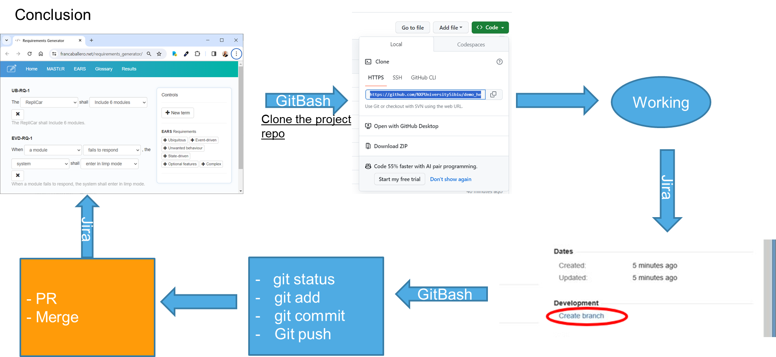
Notes:
switches you on the specified branch (e.g. switch on master => head -> master)
the detached head appears only when you check out commits, as the head no longer points to your most recent commit.

Slide 54
ENVIRONMENT SET-UP

Slide 55
Install VirtualBox
Prerequisites
40 GB free space on disk
Enable Virtualization. If is disabled, please search on google the procedure specific for your own laptop ( e.g. search on google How to Enable Virtualization on HP Latitude xxx) - Usually this is activated by default on most models.
Install VirtualBox - v7 is required
Download VM image - Eat-Sleep-Code-Repeat.ova
Eat-Sleep-Code-Repeat.ova - Google Drive

Slide 56
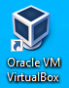
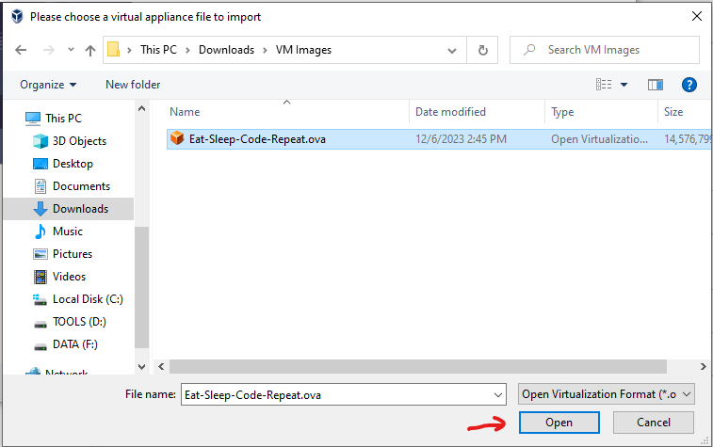
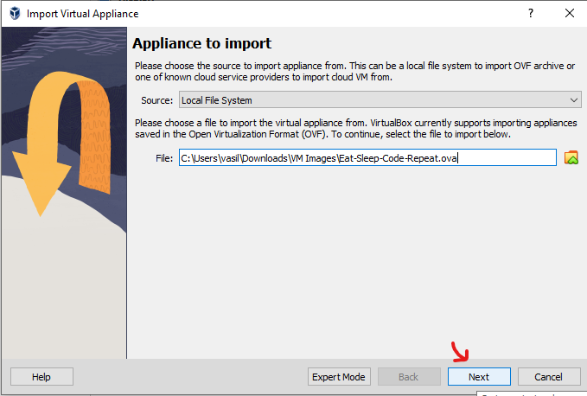
Import Image into VirtualBox
Start VirtualBox
Go to File->Import Appliance… menu ( Ctrl+I)
Browse and select the downloaded Eat-Sleep-Code-Repeat.ova

Slide 57
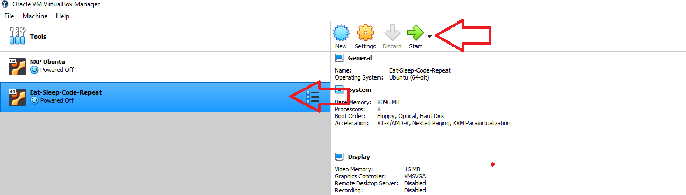
Import Image into VirtualBox
Select Eat-Sleep-Code-Repeat and then press Start button
Default username: student
Default password: student

Slide 58
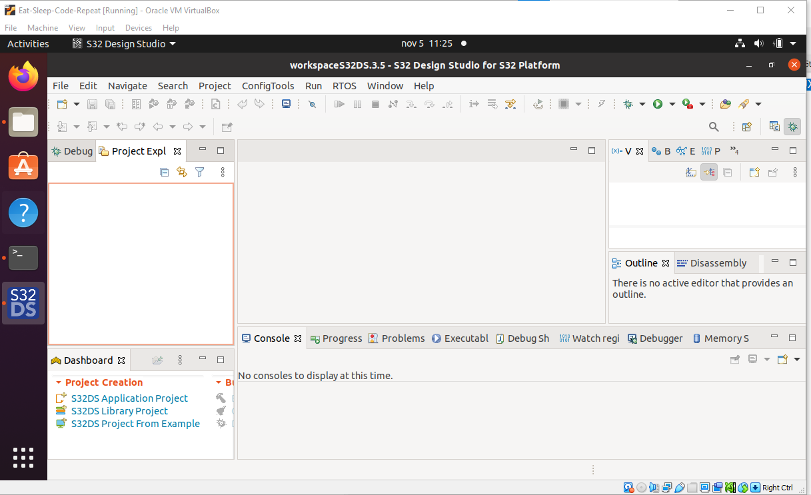
Import Image into VirtualBox

Slide 59
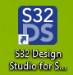
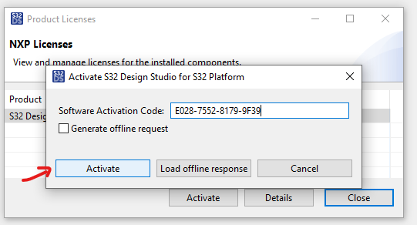
Activate S32DS
Start S32 Design Studio for S32 Platform 3.5
Open terminal in /home/student/NXP/S32DS.3.5
sudo ./s32ds.sh
Design : Product Download : Files
Use this activation code E028-7552-8179-9F39, 084A-7BE8-C06C-A982
Use online activation – Internet connection is required
DISCLAIMER! - Don't share the activation code!

Slide 60
S32K144 board ON VM
Set-up debug configuration & exercise

Slide 61
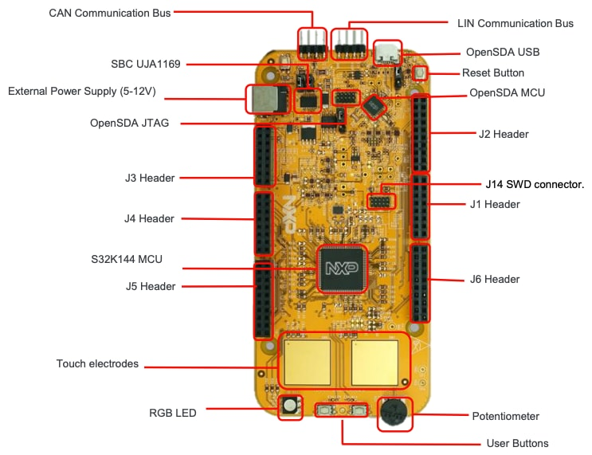
S32K144
02
Get to Know Your Evaluation Board

Slide 62
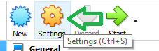
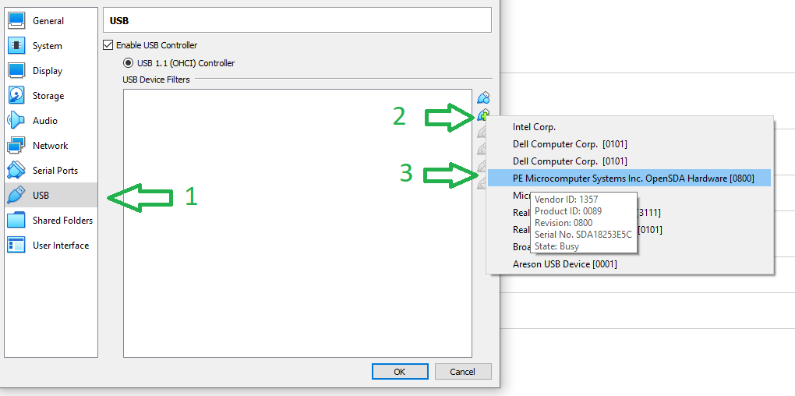
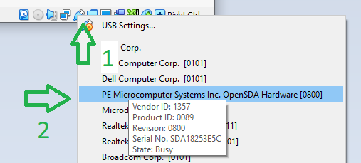
Attach Board to VM
Option 1: With VM turned OFF, select the VM and click on Settings button or press Ctrl+S keys
Select USB node then click on Add new USB filter... And from the list select PE Microcomputer Systems Inc….. device
Option 2: With VM running, from the right-bottom of the VM screen, right click on USB icon and select PE Microcomputer Systems Inc….. device from the list

Slide 63
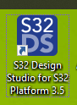
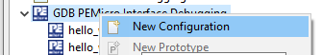
Create DEBUG Configuration
Start S32 Design Studio for S32 Platform 3.5
Select hello world project
Build project – click Project > Build All (Ctrl+B)
Click Run > Run or Run > Debug.
Expand GDB PEMicro Interface Debugging
If there is no entry like {project_name}_Debug_FLASH create a new configuration -> right click on GDB PEMicro Interface Debugging -> New Configuration

Slide 64
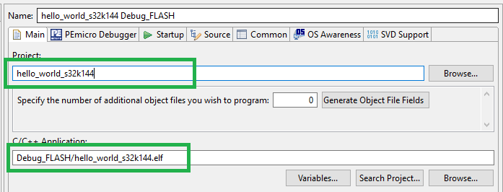
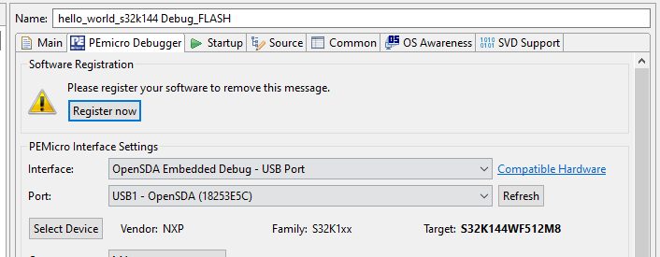
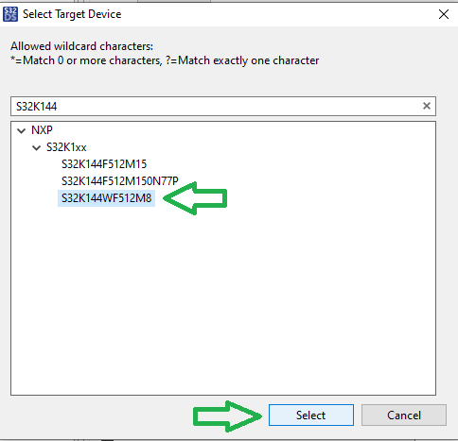
Create DEBUG Configuration
In the Main tab select Project and C/C++ Application
In the Pemicro Debugger tab set Interface, Port
Click on Select Device and select S32K144WF512M8 device
Click on Debug button – the project will be flashed on board and the application will start to run on this.
From this point, the Debug perspective will be opened and the execution will stop at the first line of main function – click F8 to resume the code execution

Slide 65

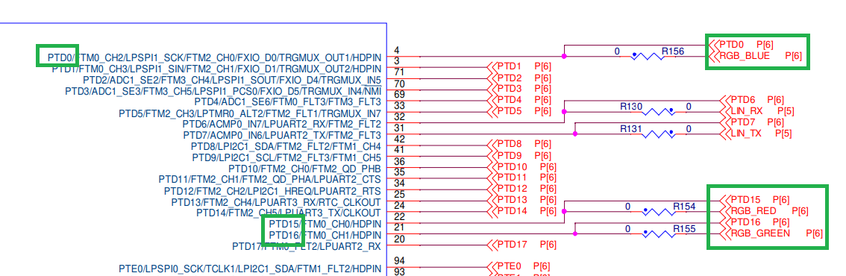
Exercise: RED-YELLOW-BLUE
The initial demo project will make the RGB LED to blink rapidly RED and GREEN colors
Scope of this exercise is to make the RGB LED to blink on RED, YELLOW and BLUE
RGB_BLUE – PTD0 ; RGB_RED – PTD15 ; RGB_GREEN – PTD16
Board pinout

Slide 66
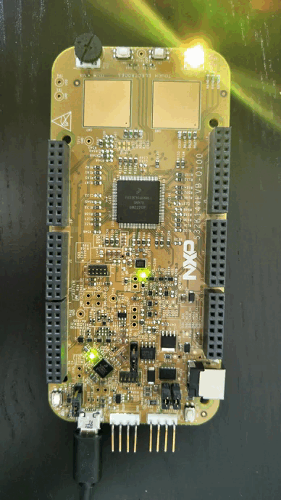
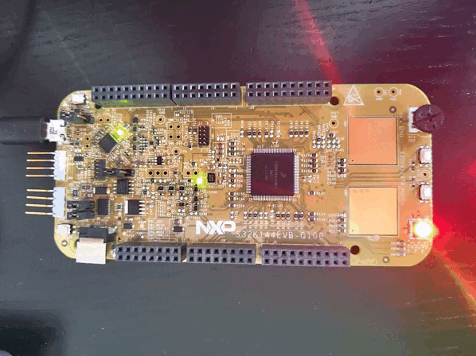
Exercise: RED-YELLOW-BLUE
Before
Target result

Slide 67
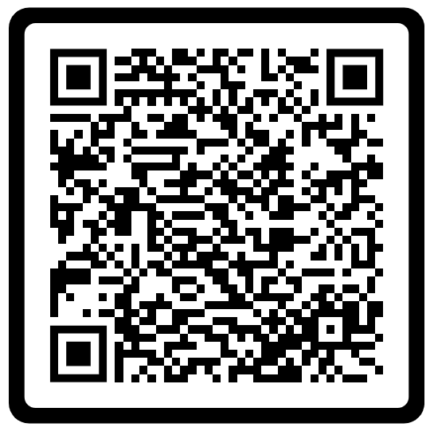

Slide 68
How Hardware and Software are Linked

Slide 69
What is Hardware and Software?
Hardware
Software
Hardware refers to the physical, tangible components of a computing system or electronic device. It includes all mechanical, electronic, and electric part that form the foundation of the system's functionality. Essentially, hardware is everything you can touch and see in a computer or device.
Software refers to the set of instructions, programs and data that run on hardware, guiding it to perform specific tasks. Unlike hardware, software is intangible; it cannot be physically touched but it plays a crucial role in controlling and managing the hardware.

Slide 70
From source code to executable
Compiling
Source Code
Preprocessor
Preprocessed file (.i file)
Compiler
Assembly code (.s file)
Assembler
Object code (.o file)
Linker
Executable

Slide 71
Writing to Flash memory
Flashing the microcontroller
Connect to microcontroller
Microcontroller initialization
Analysis of the ELF file
Writing in FLASH memory
Memory check
Completion of the process

Slide 72
Code execution
fetch–decode–execute cycle
Start
Address in PC copied to MAR
PC increment
Instruction from MAR copied to MDR
Instruction from MDR copied to CIR
CU decodes the contents of the CIR
CU send signals to relevant components(e. g. ALU)
Notes:
MAR - Memory address register
MDR – Memory data register
CIR – Current instruction Register
CU – Control Unit
ALU – Arithmetic logic unit

Slide 73
S32K144
02
Get to Know Your Evaluation Board

Slide 74
Microcontroller Features | Hands-on Lab I/O, PWM, ADC, DAC, Timer, Interrupts

Slide 75
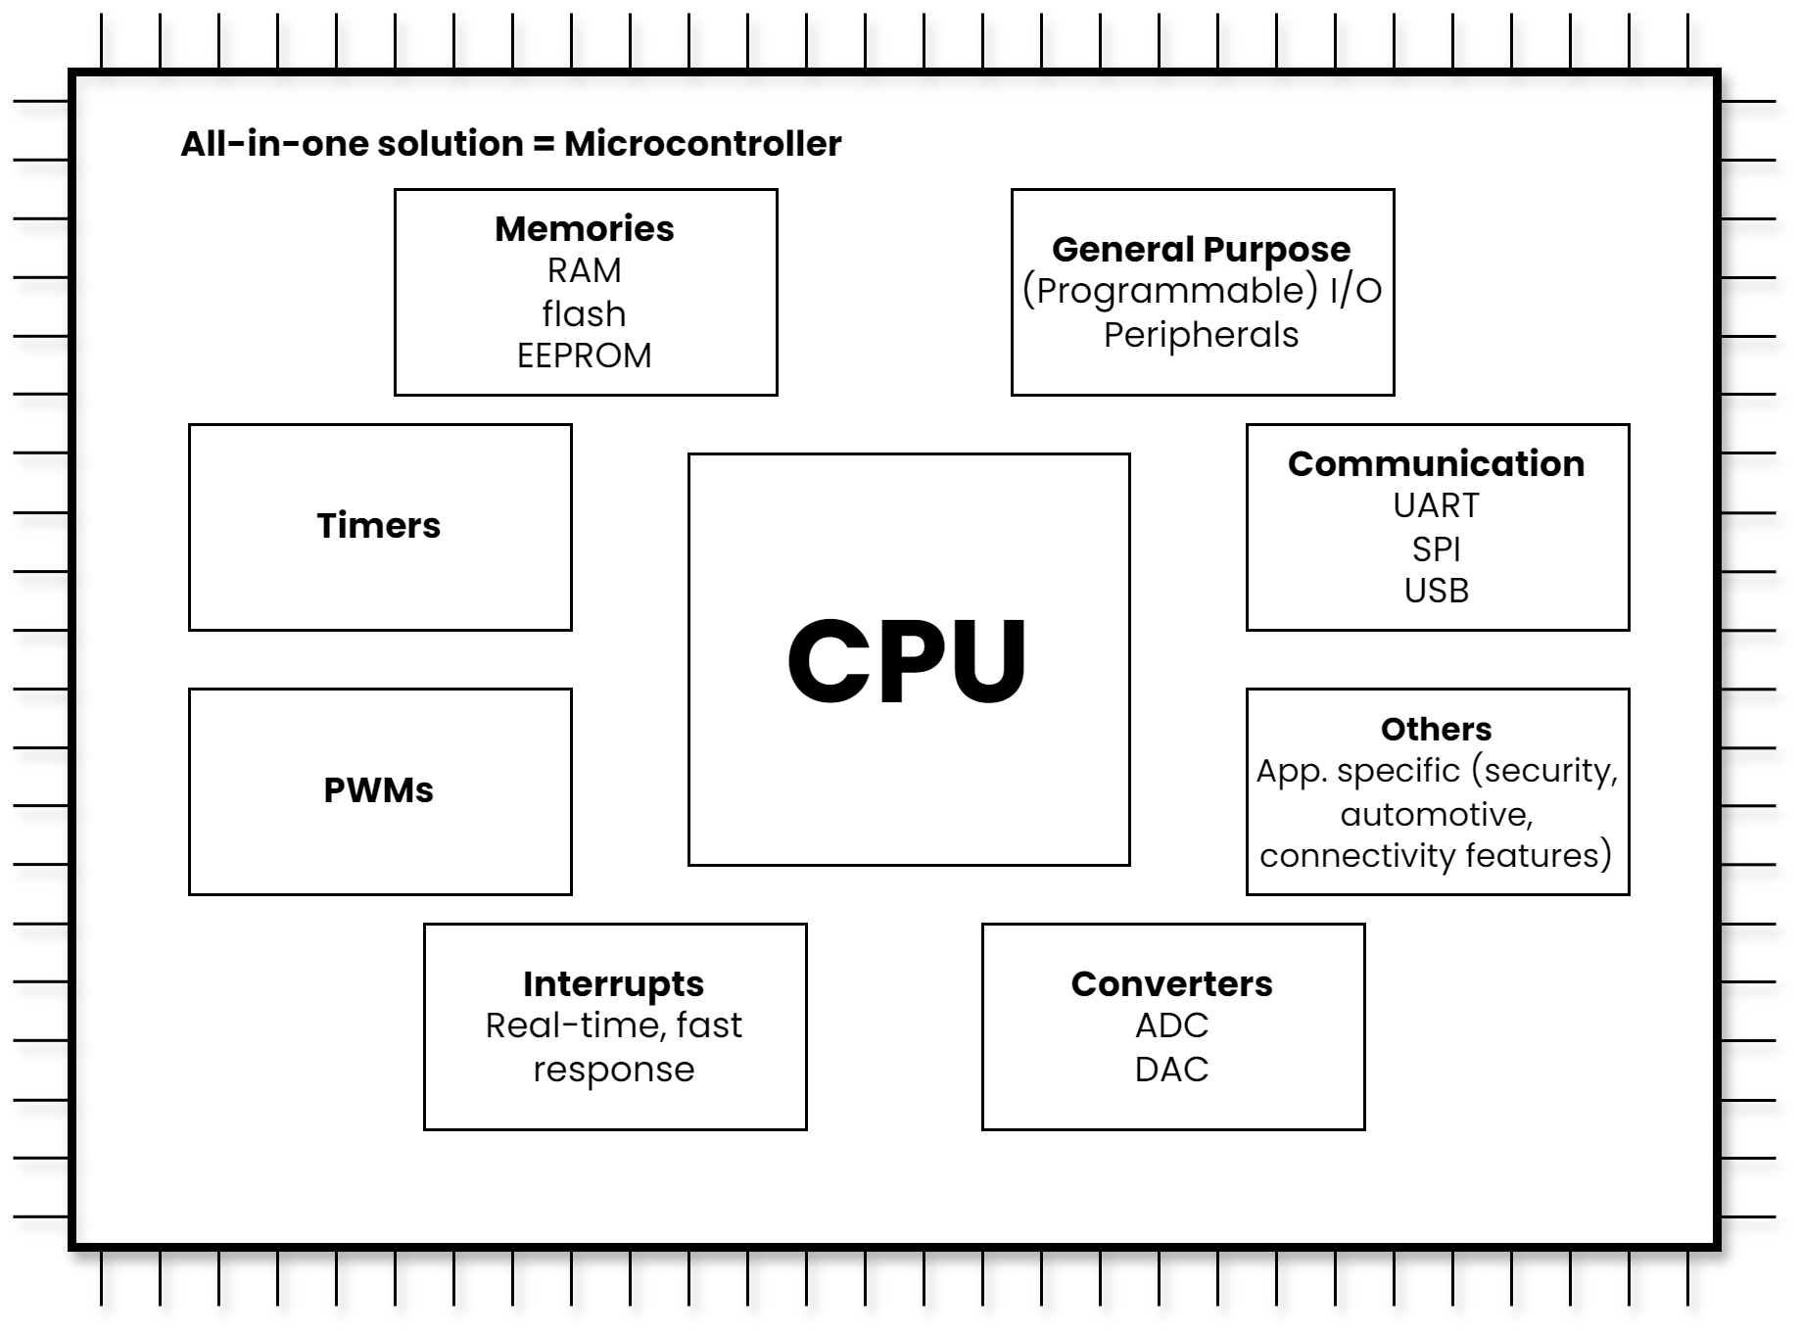
What IS a microcontroller?

Slide 76
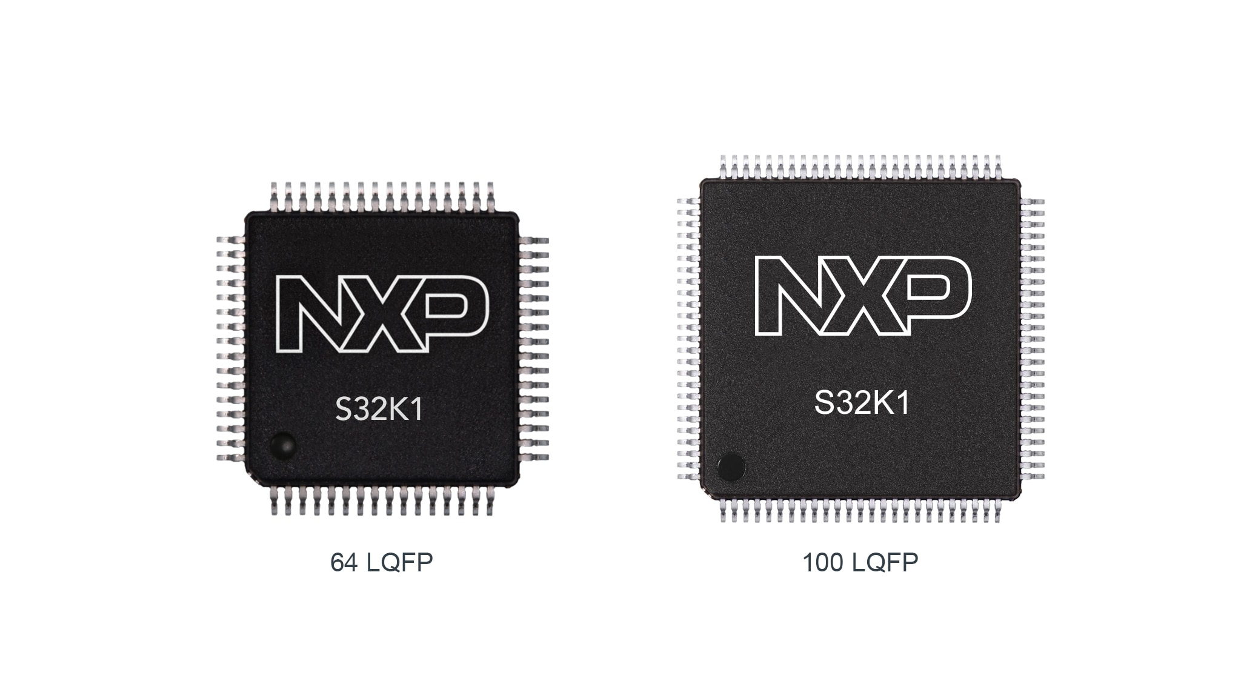
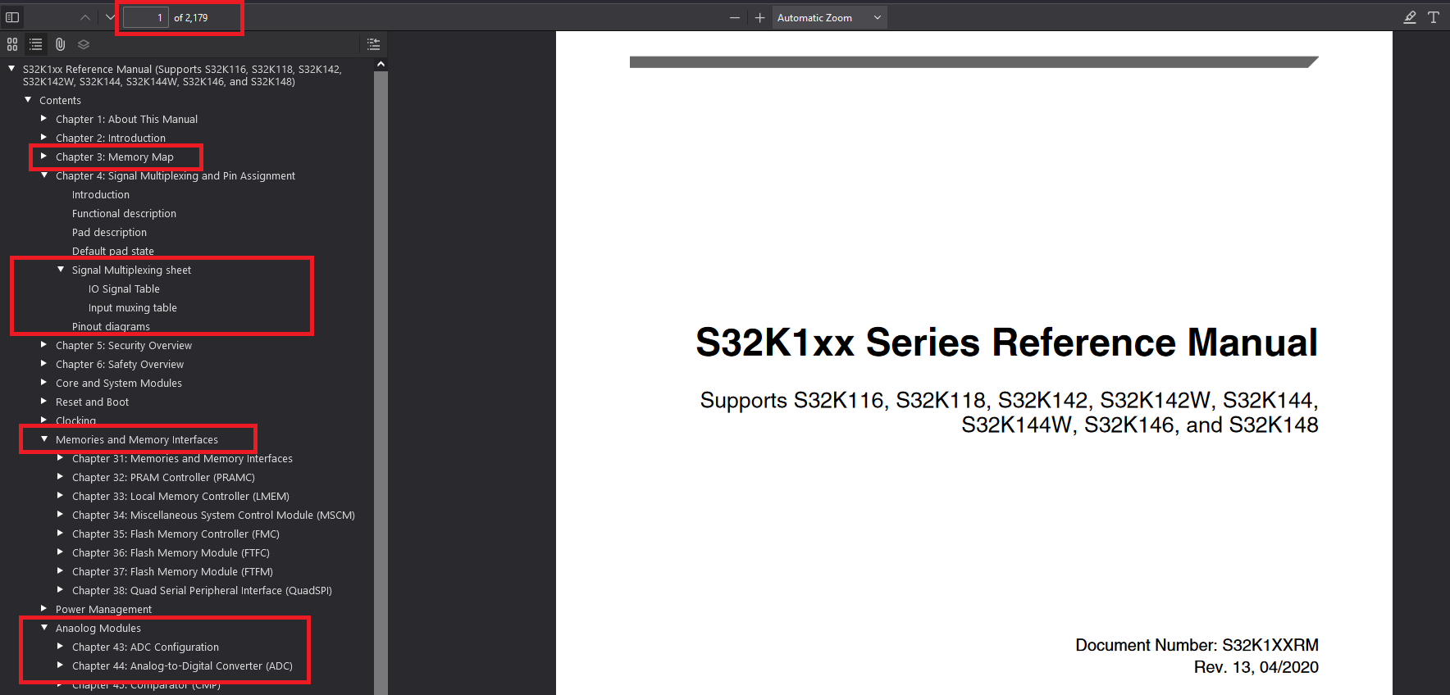
What IS a microcontroller?
S32K1 Microcontrollers for Automotive General Purpose
S32K1xx Series Reference Manual (PDF Download)

Slide 77
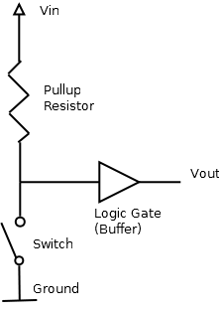
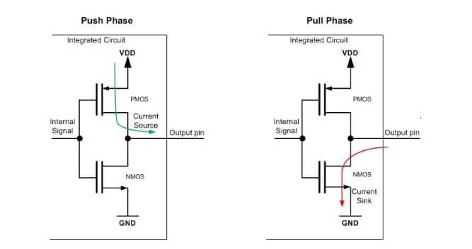
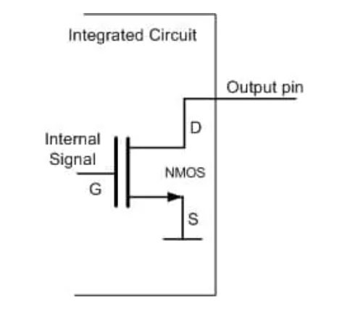
I/O – Input/Output Peripheral
4 types of GPIO modes:
Input mode – receive data from external input device (sensor)
Pull-up, Pull-down, Floating point configurations
Output mode
Push-pull, Open drain configurations
Analog mode – ADC, DAC
Alternate function mode – USART, I2C pins, etc.

Slide 78
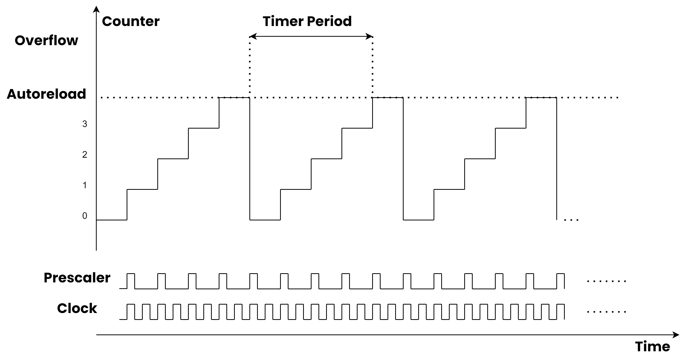

Timers
Great overview on timers:
Introduction to Microcontroller Timers: Periodic Timers - Technical Articles
For further information, please check out this Application Note!
AN5303: Features and Operation Modes of FlexTimer Module on S32K – Application Note

Slide 79
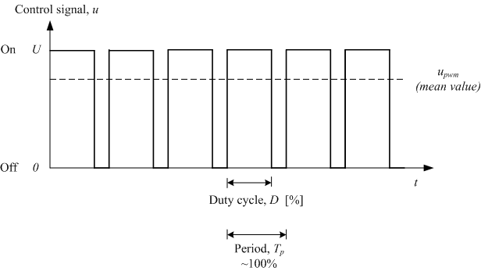
PWM – Pulse Width Modulation
PWM = generates a rectangular wave signal with variable duty cycle.
Duty Cycle describes the proportion of “on” time to the regular interval or period.
Period - the time it takes for a signal to conclude a full ON-OFF cycle
The voltage amplitude here is 0V–5V.

Slide 80
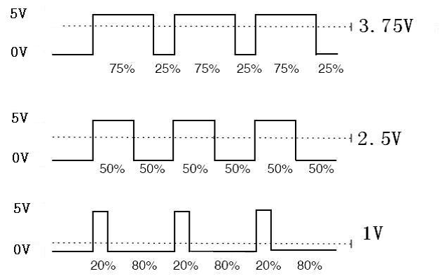
PWM – Pulse Width Modulation
The PWM can simulate intermediate voltage levels between fully ON (5 Volts) and OFF (0 Volts) by adjusting the proportion of time the signal remains ON within each cycle.
Use cases:
Control the average power or amplitude delivered by a signal
Control servomechanisms,
Power delivery,
Voltage regulation

Slide 81


ADC and DAC – Analog-to-Digital and Digital-to-Analog Converters
ADC and DAC
For further information, please check out this Application Note!
S32K1xx and S32M24x ADC Guidelines, Spec and Configuration

Slide 82



Interrupts
Arm Cortex-M4 Processor Technical Reference Manual Revision r0p1

